Slide 1
Functions

Slide 2
Suppose that to each element of a set A we assign a unique element of a set B; the collection of such assignments is called a function from A into B.
The set A is called the domain of the function,
The set B is called the target set or codomain

Slide 3
Functions are ordinarily denoted by symbols. For example, let f denote a function from A into B. Then we write
f: A → B
which is read: “f is a function from A into B,” or “f takes (or maps) A into B.”
If a ∈ A, then f (a) (read: “f of a”) denotes the unique element of B which f assigns to a; it is called the image of a under f, or the value of f at a.
The set of all image values is called the range or image of f.
The image of f : A → B is denoted by Ran(f ), Im(f ) or f (A).

Slide 4
A function can be expressed by means of a mathematical formula.
For example, consider the function which sends each real number into its square.
We may describe this function by writing f (x) = x² or y = x²
In the first notation, x is called a variable and the letter f denotes the function. In the second notation, x is called the independent variable and y is called the dependent variable since the value of y will depend on the value of x.

Slide 5
Consider the function f (x) = x³, i.e., f assigns to each real number its cube. Then the image of 2 is 8, and so we may write f (2) = 8.

Slide 6
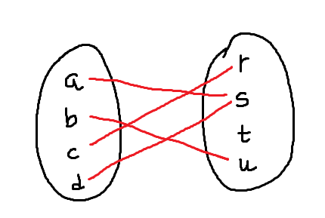
a function f from A = {a, b, c, d} into B = {r, s, t, u} in the obvious way.
f (a) = s, f (b) = u, f (c) = r, f (d) = s
The image of f is the set of image values, {r, s, u}. Note that t does not belong to the image of f because t is not the image of any element under f.

Slide 7
Functions as relations
every function f: A → B gives rise to a relation from A to B called the graph of f
and defined by Graph of f = { (a, b)| a ∈ A, b = f (a)}
Two functions f : A → B and g: A → B are defined to be equal, written f = g, if f (a) = g(a) for every a ∈ A; that is, if they have the same graph
we do not distinguish between a function and its graph
Now, such a graph relation has the property that each a in A belongs to a unique ordered pair (a, b) in the relation.

Slide 8
On the other hand, any relation f from A to B that has this property gives rise to a function f : A → B, where f (a) = b for each (a, b) in f
Consequently, one may equivalently define a function as follows:
A function f: A → B is a relation from A to B (i.e., a subset of A × B) such that each a ∈ A belongs to a unique ordered pair (a, b) in f

Slide 9
Let f: A → B be the function defined here
Then the graph of f is as follows: {(a, s), (b, u), (c, r), (d, s)}

Slide 10
Consider the following three relations on the set A = {1, 2, 3}:
f = {(1, 3), (2, 3), (3, 1)},
g = {(1, 2), (3, 1)},
h = {(1, 3), (2, 1), (1, 2), (3, 1)}
is a function from A into A since each member of A appears as the first coordinate in exactly one ordered pair in f; here f (1) = 3,f(2) = 3, and f (3) = 1.
g is not a function from A into A since 2 ∈ A is not the first coordinate of any pair in g and so g does not assign any image to 2.
Also h is not a function from A into A since 1 ∈ A appears as the first coordinate of two distinct ordered pairs in h, (1, 3) and (1, 2). If h is to be a function it cannot assign both 3 and 2 to the element 1 ∈ A.

Slide 11
Kinds of Functions
Identity
Injective
Surjective
Bijective
Inverse

Slide 12
Identity function
Let A be any set. The function from A into A which assigns to each element in A the element itself is called the identity function on A and it is usually denoted by 1_{A}, or simply 1.
In other words, for every a ∈ A, 1_{A}(a) = a

Slide 13
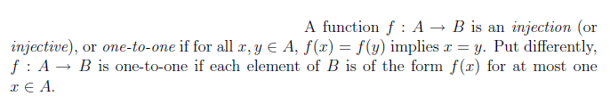
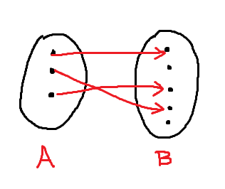
Injective

Slide 14
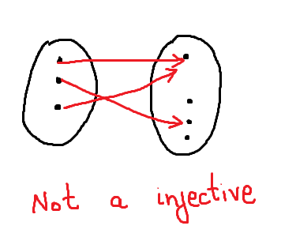
Injective

Slide 15
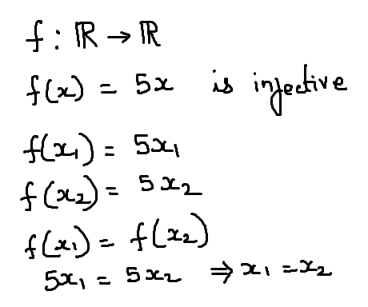
Example

Slide 16
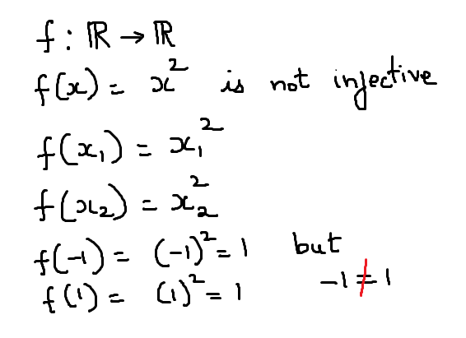
example

Slide 17
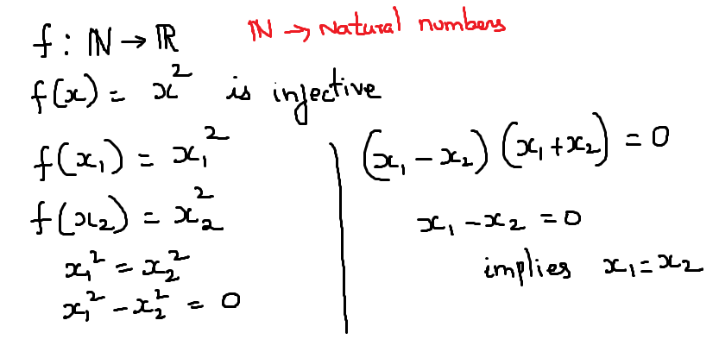
Example

Slide 18
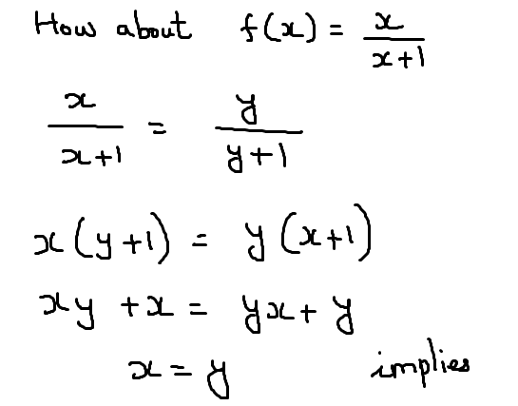
Example

Slide 19
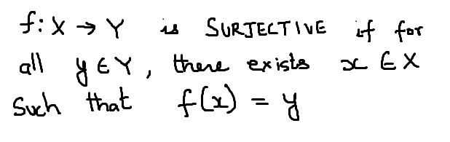
Surjective

Slide 20
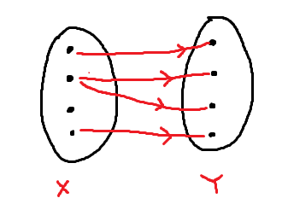
Surjective

Slide 21
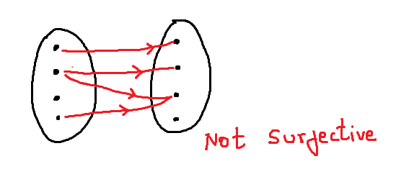
Surjective

Slide 22
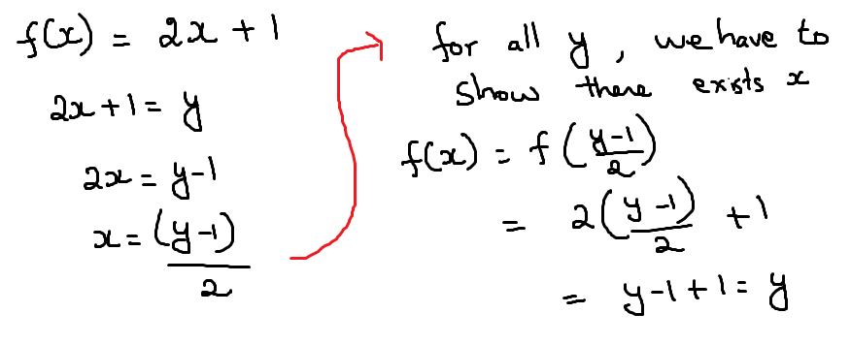
Example of Surjective

Slide 23
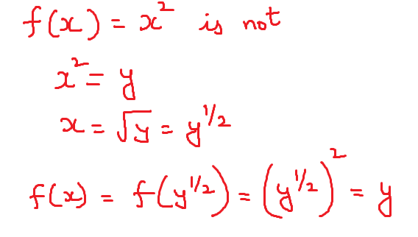
Not surjective

Slide 24
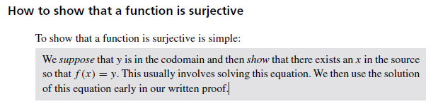

Slide 25
Bijective

Slide 26
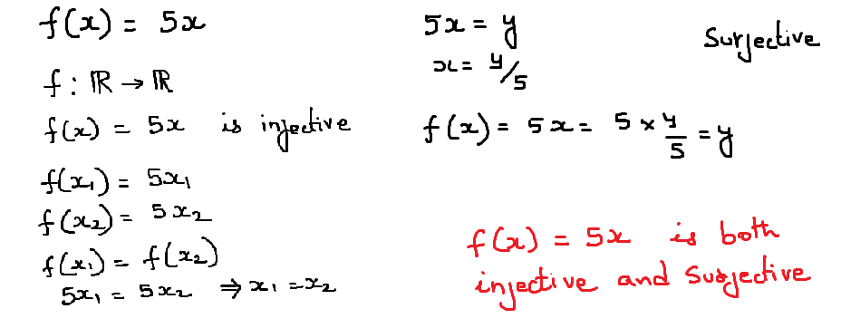

Slide 27
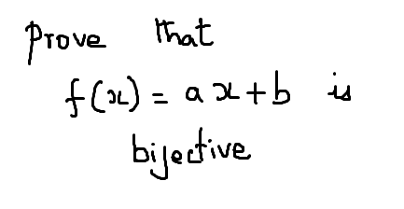
Exercise

Slide 28
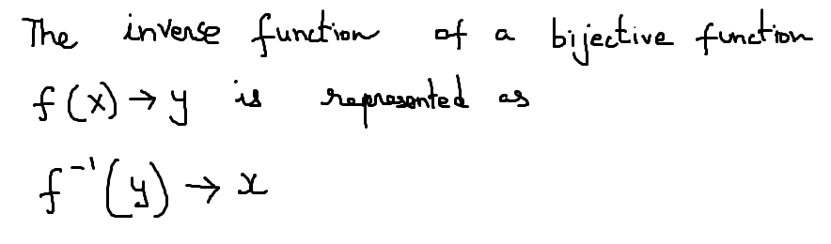
Inverse function

Slide 29
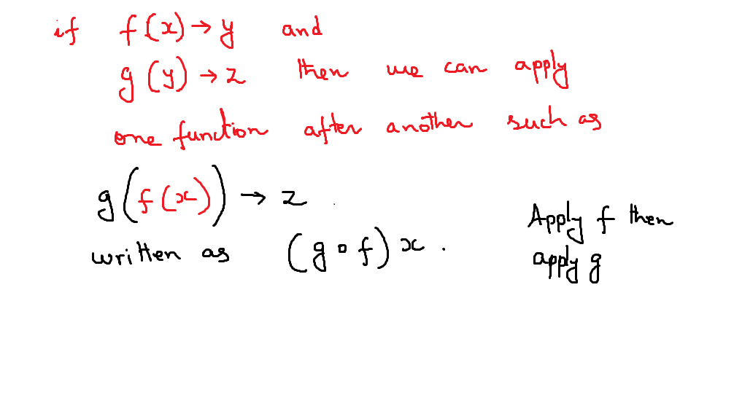
Composition of functions

Slide 30
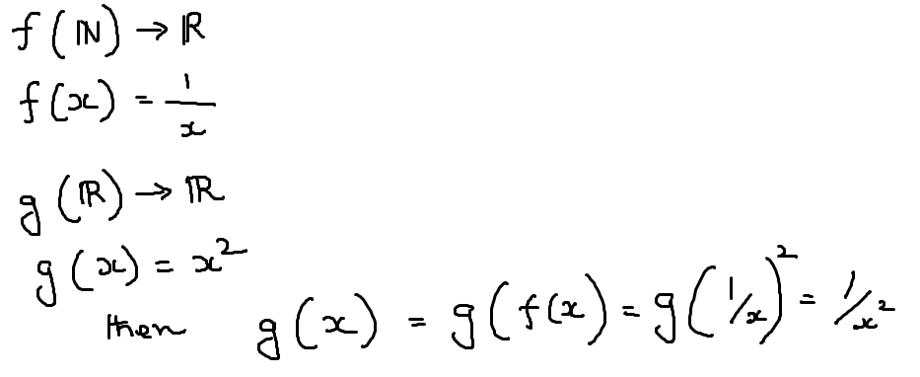
Composition

Slide 31
MATHEMATICAL FUNCTIONS, EXPONENTIAL AND LOGARITHMIC FUNCTIONS
Floor and Ceiling Functions
Let x be any real number. Then x lies between two integers called the floor and the ceiling of x. Specifically

Slide 32
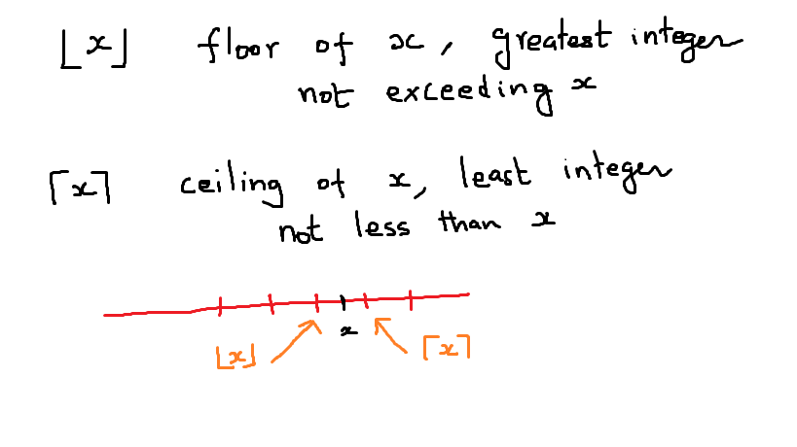

Slide 33
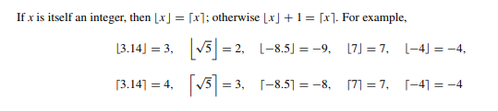

Slide 34
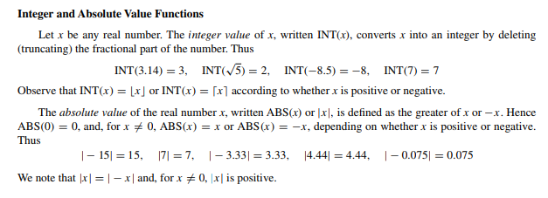

Slide 35
Remainder Function
Let k be any integer and let M be a positive integer. Then k (mod M) (read: k modulo M) will denote the integer remainder when k is divided by M.
More exactly, k (mod M) is the unique integer r such that
k = Mq + r where 0 ≤ r < M

Slide 36
when k is positive
simply divide k by M to obtain the remainder r.
Thus 25 (mod 7) = 4,
25 (mod 5) = 0,
35 (mod 11) = 2,
3 (mod 8) = 3

Slide 37
If k is negative,
divide |k| by M to obtain a remainder r' ; then k (mod M) = M − r' when r = 0. Thus
−26 (mod 7) = 7 − 5 = 2,
−371 (mod 8) = 8 − 3 = 5,
−39 (mod 3) = 0

Slide 38
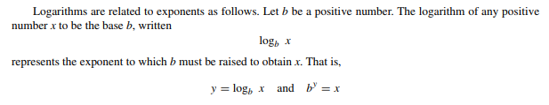

Logarithmic Functions

Slide 39

Logarithmic Functions

